Slide 1
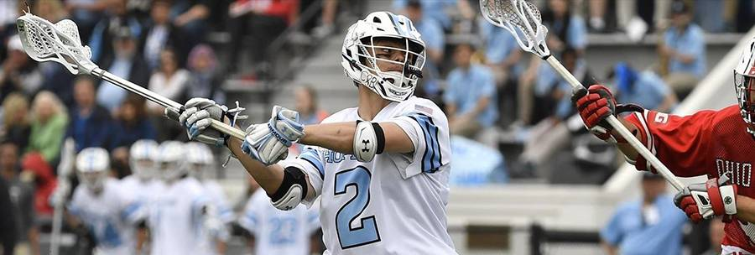
Laxbit - The Lacrosse Stick Motion Tracker
Wyatt Marvil, Patrick Mullin, Lance Whitley
Notes:
Beef up the motivation slide; let the audience really know wassup
Propsal slide should be a single sentence!!!
The current proposal slide will follow it
Then have 3 slides after that to go more in depth on each individual stage

Slide 2
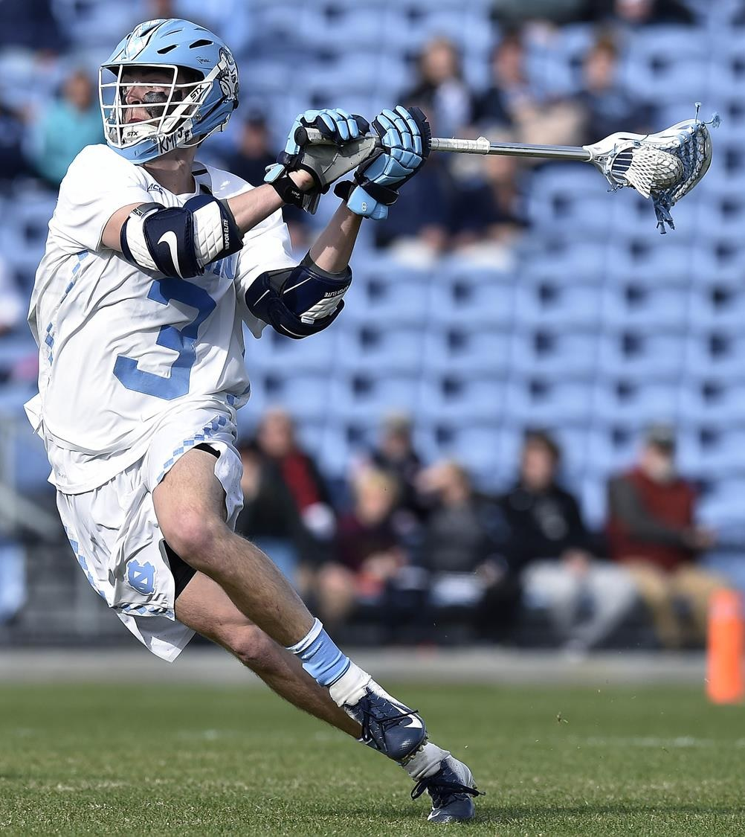
Motivation
Unfulfilled niche
Complexity of movements
High speed

Slide 3
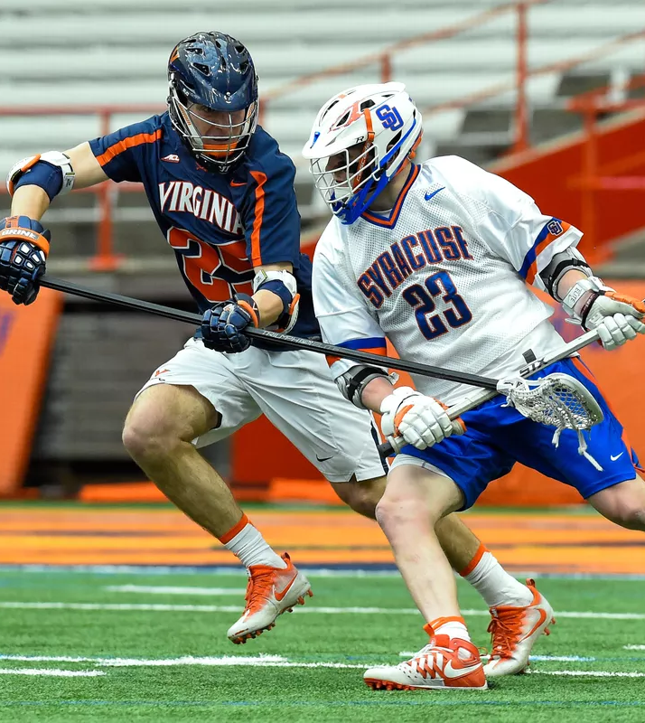
Proposal
Sensors
Data collection app
Recurrent neural network

